Slide 1
CookItUp
An easy-to-use mobile app that suggests recipes with your available ingredients
Avantika Mishra – 2022SP93049
Hritika Dhasal – 2022SP93058
Amit Raj – 2022SP93059

Slide 2
Table of Contents
01
02
03
04
About Project
Architecture/Design
Overview and objectives of our project
Choices to achieve the best performance and user experience
Preview of App
Highlighting Features
A brief preview of how our app looks
Challenges and interesting aspects of our project

Slide 3
About Project

Slide 4
A cross-platform application designed for users who want to create delicious meals using the ingredients they have on hand. The app leverages the power of Large Language Models (LLMs) and image recognition technology to identify edible ingredients from images provided by the user and then recommends detailed recipes based on these ingredients.
After carefully evaluating numerous available APIs and techniques, we opted for the Google Vision API to identify edible ingredients within images. And for generating valid recipes, we are leveraging the cutting-edge technology of Generative AI.

Slide 5

Architecture
The basic design and architecture, that we used to ensure robust performance and seamless user experiences across diverse devices and platforms.

Slide 6






Response status sent
If(image) searchQuery = imageURL
If image, imageUrl sent
If(!image)
searchQuery = formData
Labels Returned
Server
Image Upload
Google Cloud Vision API
Image URL
Prompt + Labels
Recipe as Response
Stores state of the request
MongoDB to store state of the Process
Cloudinary
GPT 3.5 Turbo API

Slide 7
Memorization
Caching at Server Side using node-cache
Process the Unstructured String / Generated Labels
Remove special characters
Convert to lower case
Sort alphabetically
Remove duplicates
Convert the array to a comma separated string
Unstructured String / URL as Request
If URL get the labels from the URL using Vision API
Now for any new request, first the application will process the string in the request and will try to search it in cache. If found in cache instant response will be provided else the normal flow will be continued
After getting response, add it to cache {request: response}
Continue the Process of getting Recipe

Slide 8
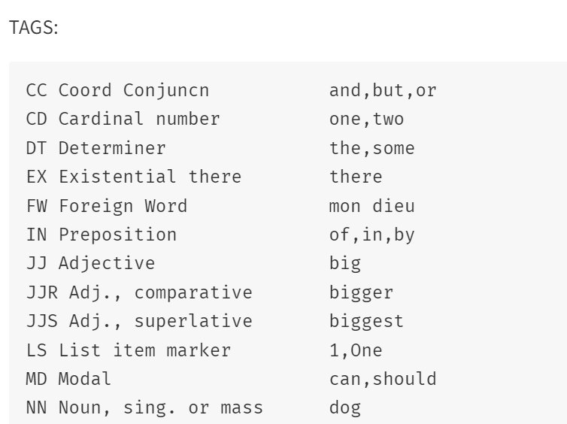
Extracting Noun from user input : POS- JS
pos-js is a Javascript port of Mark Watson's FastTag Part of Speech Tagger which was itself based on Eric Brill's trained rule set and English lexicon.
pos-js also includes a basic lexer that can be used to extract words and other tokens from text strings.
It works by assigning tags to each word as shown in the example.
We have used it to extract nouns out of user input
USAGE:
var pos = require('pos');
var words = new pos.Lexer().lex('This is some sample text. This text can contain multiple sentences.');
var tagger = new pos.Tagger();
var taggedWords = tagger.tag(words);
for (i in taggedWords) {
var taggedWord = taggedWords[i];
var word = taggedWord[0];
var tag = taggedWord[1];
console.log(word + " /" + tag);
}
// extend the lexicon
tagger.extendLexicon({'Obama': ['NNP']});
tagger.tag(['Mr', 'Obama']);
// --> [[ 'Mr', 'NNP' ], [ 'Obama', 'NNP' ]]

Slide 9

Preview

Slide 10
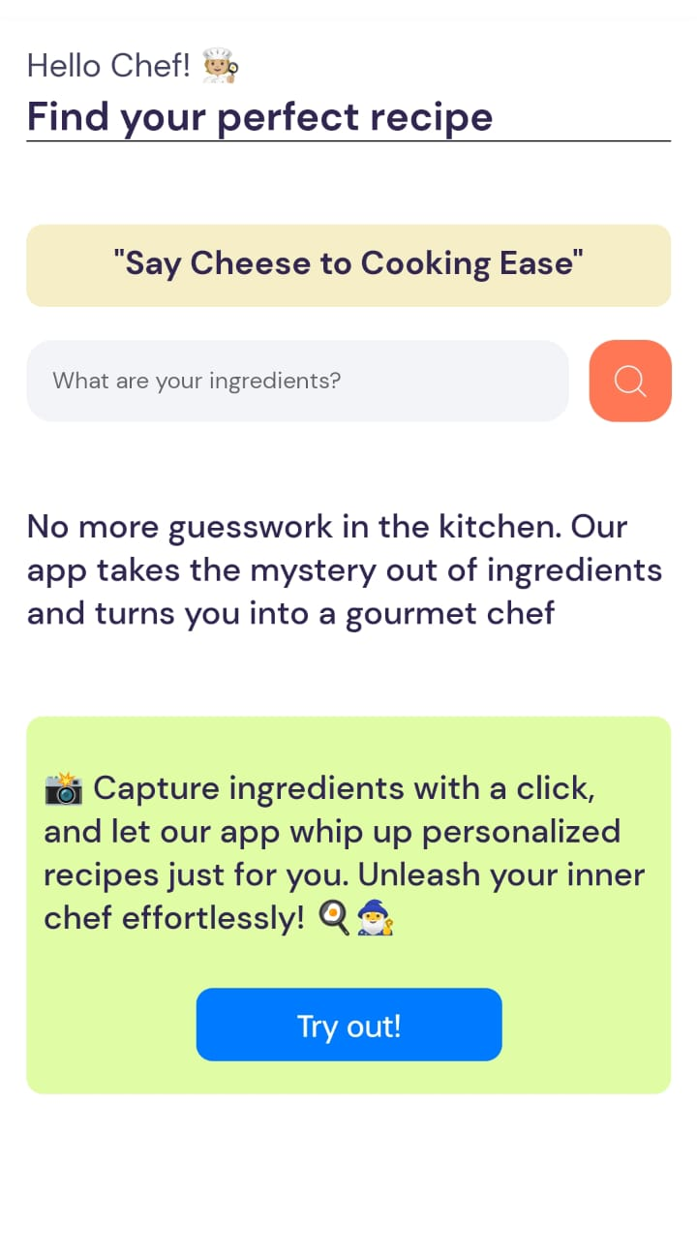
Home Page
Text input box where user can enter ingredients directly as text
Redirect to camera where users can click the image of the ingredients

Slide 11
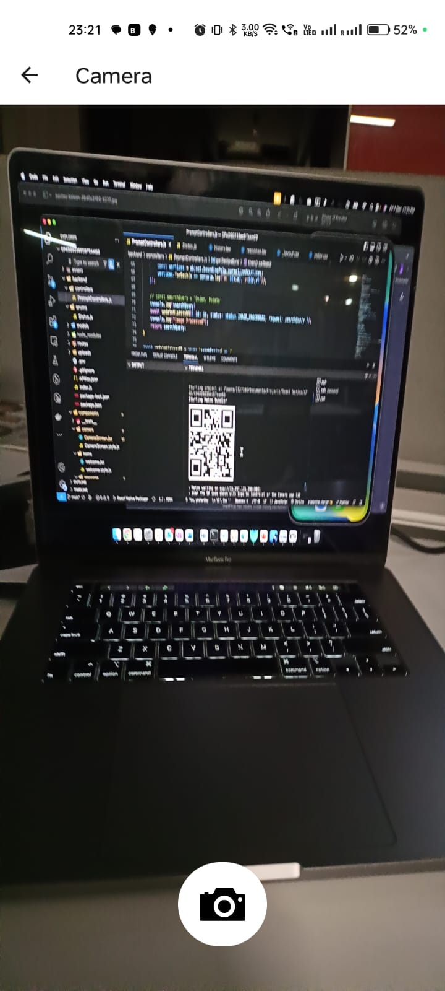
Camera Screen
This is how our camera screen looks, while the user tries to click a picture to send to the backend

Slide 12
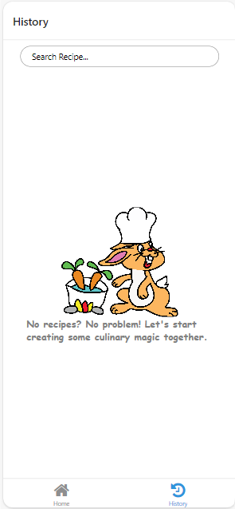
Fresh History Page
History Page appears blank like this when there us no data in the db.

Slide 13
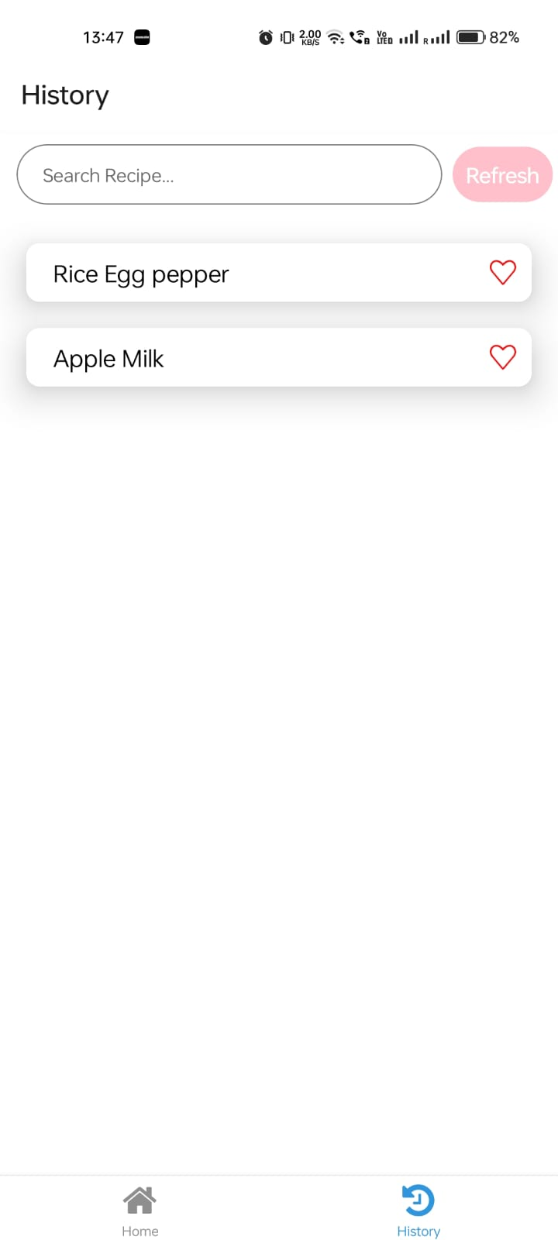
History
History Page that displays top 10 Search Results and lets users search within that.

Slide 14
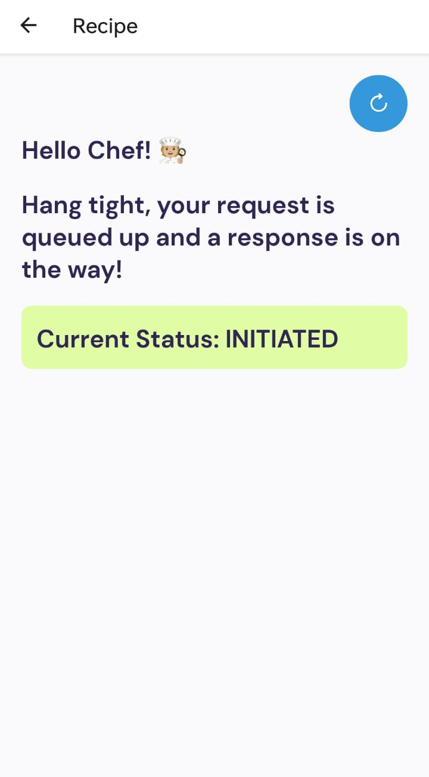
Response Screen
Users see this screen after submitting their picture or text query. This tells them the status of their query, and finally returns the recipe.

Slide 15
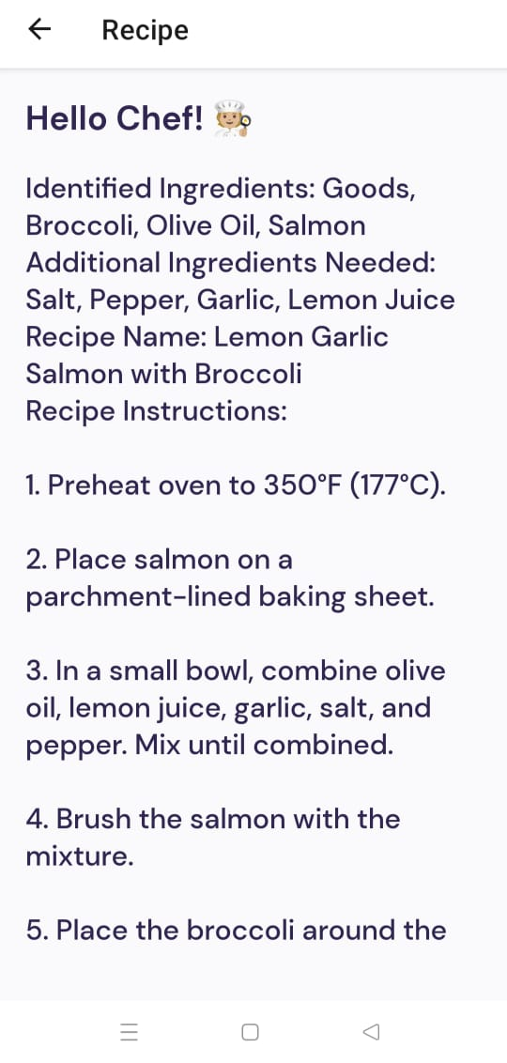
Successful Response Screen
Users see this screen after submitting their picture or text query. This tells them the status of their query, and finally returns the recipe.

Slide 16

Highlighting Features
Some challenging yet interesting aspects of our project.

Slide 17
Workflow for input-type == Image
Cloudinary
LLM
Object Recognition
Media Management Solution
Prompt Engineering
We pass the imageUrl obtained from Cloudinary to the vision API to identify the items in the given image
It helps in efficient cloud-based media management and optimization. Opting for Cloudinary, our solution streamlines image management by uploading images to the platform, securing optimized URLs for seamless integration across APIs. Additionally, Cloudinary's resizing capabilities ensure quality preservation, mitigating potential issues stemming from large image sizes.
Finally, we perform prompt engineering to identify edible items from the identified labels, and suggest recipes using them.
Google Vision API

Slide 18

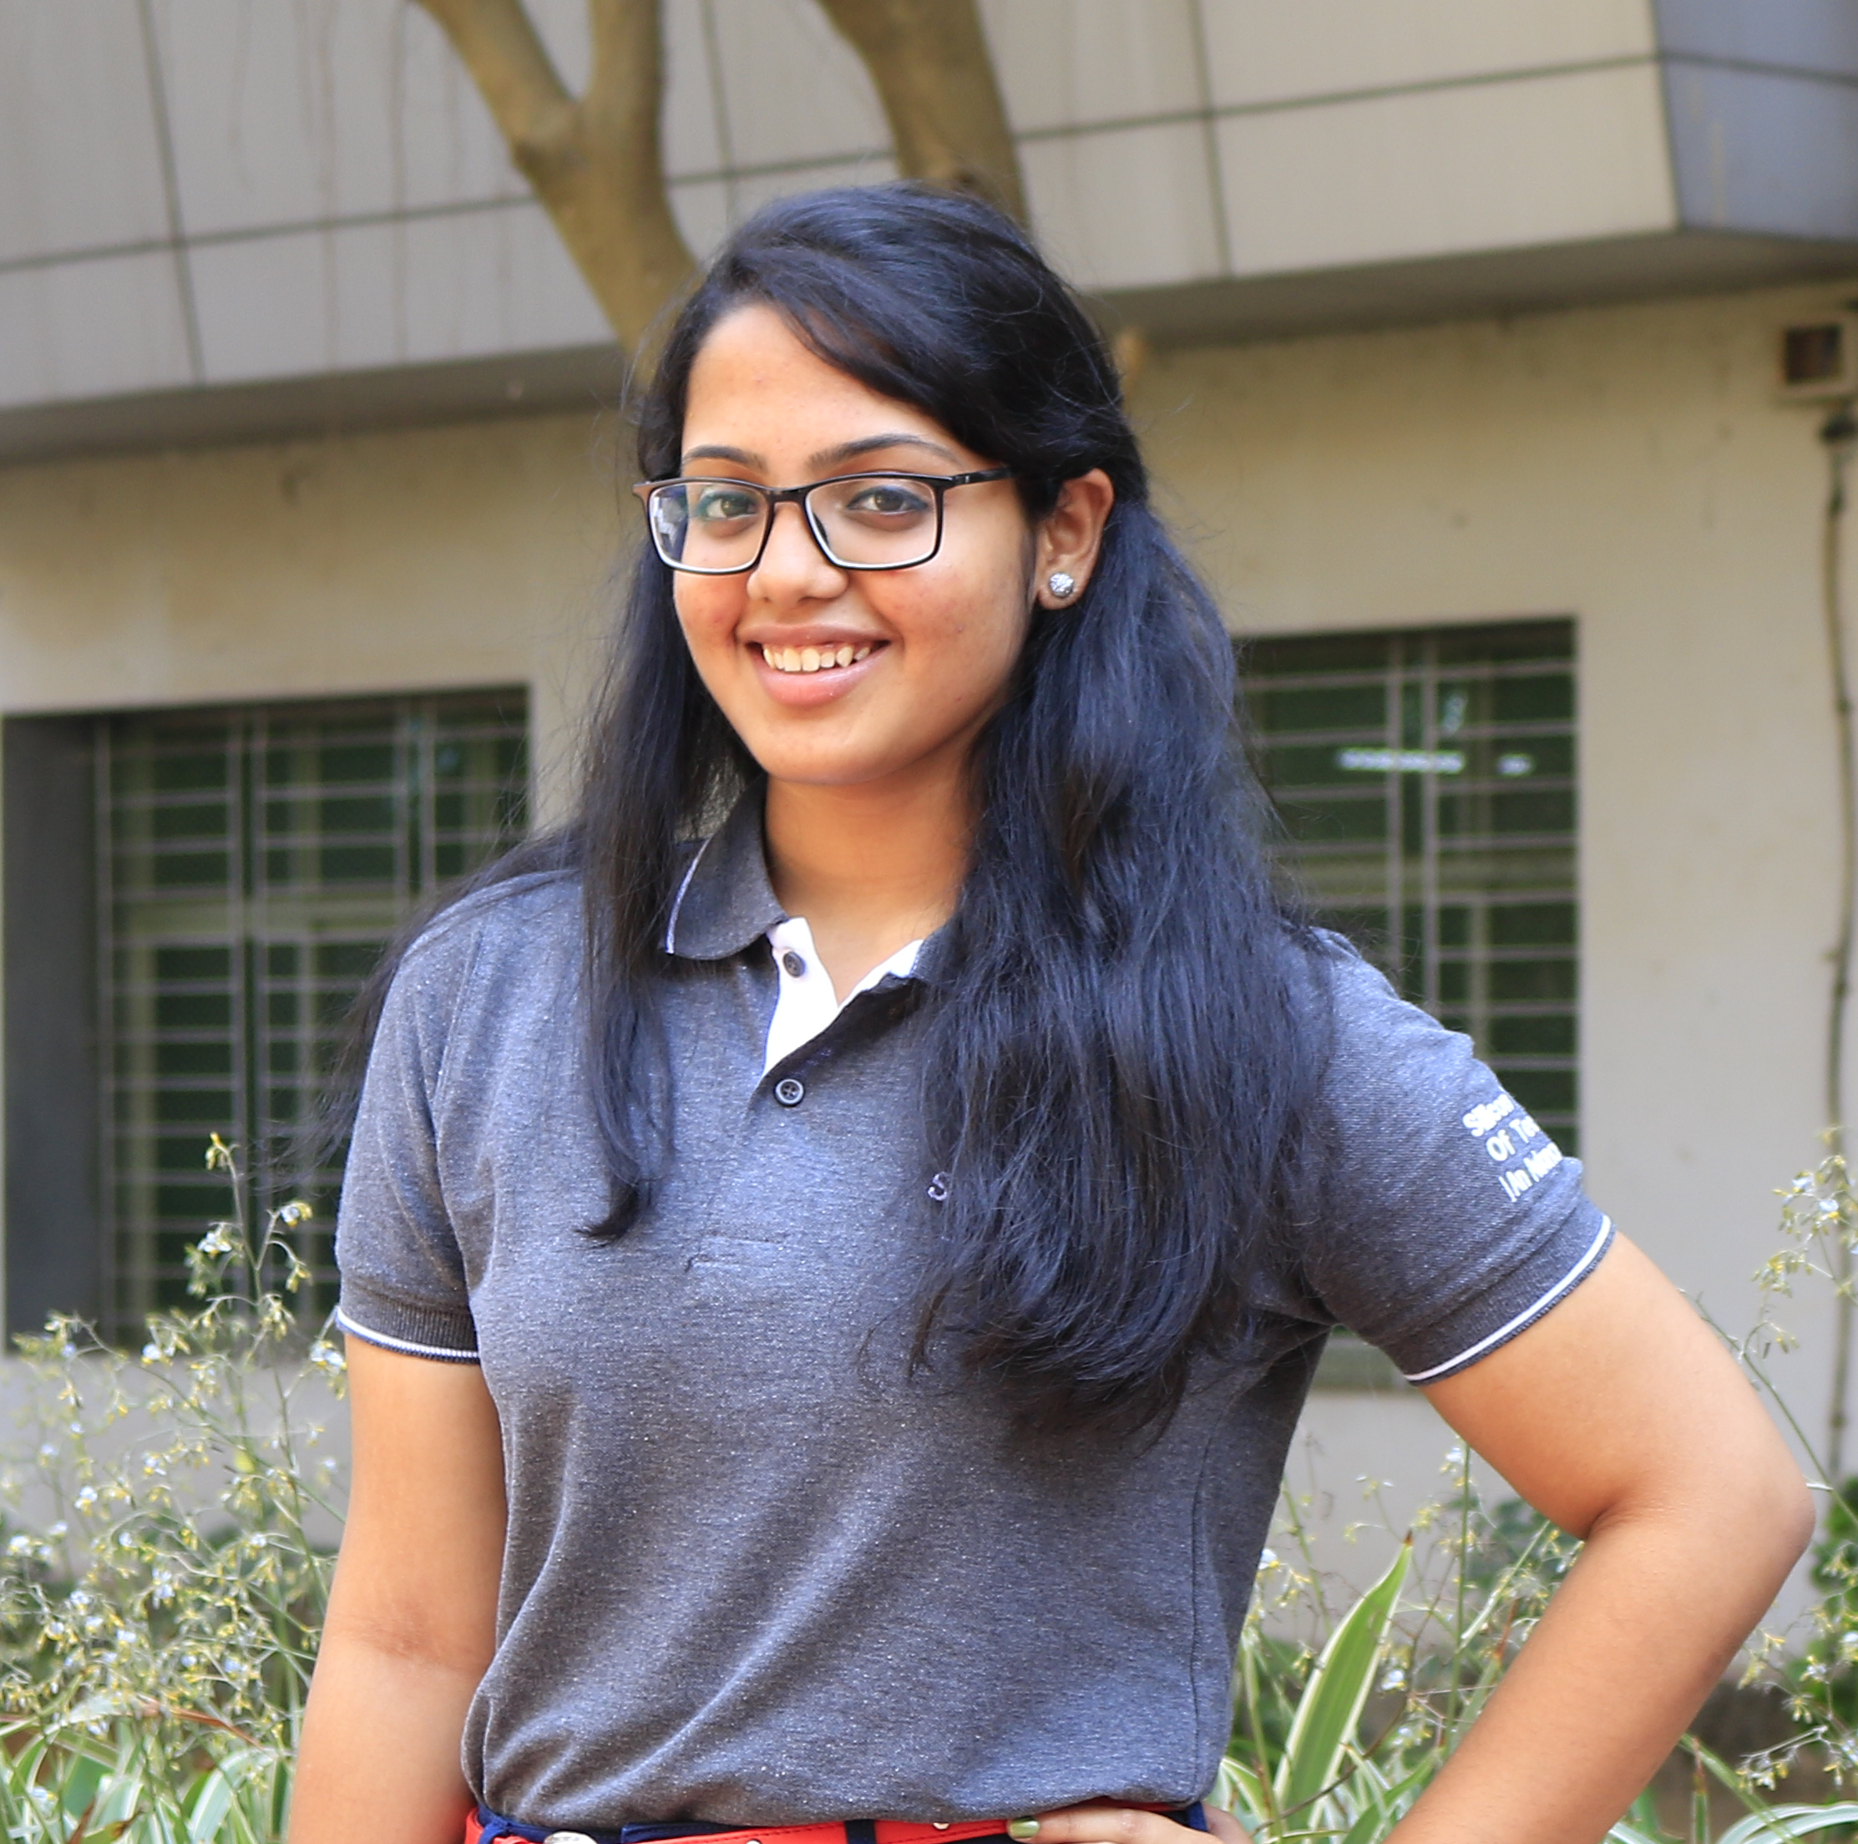

Our Team
Amit Raj
Avantika Mishra
Hritika Dhasal
Full-stack developer
2022SP93059
2YB 2022
Back-end developer
2022SP93049
2YB 2022
Front-end developer
2022SP93058
2YB 2022

Slide 19
Thanks!
Please keep this slide for attribution

